Slide 1

AUTONOMOUS VEHICLE CONTROL
THROUGH TRAFFIC SIGNS
Group No: 1
AKANKSHA SINGH 101904104
AYUSH VASHISTH 101904020
GURSIMAR SINGH NAGPAL 101904114
VINAY KUMAR JAIN 101904017
YASHVARDHAN PACHAURI 101954095
Supervisor: Dr. SANJAY K. JAIN
Dr. VISHAL SRIVASTAVA
www.thapar.edu

Slide 2

List of content
1. Introduction
Need Analysis
Objectives and deliverables
Working Principle
Assumptions and Constraints
Technical standards used
Proposed methodology
Functional Block Diagram
Simulation/hardware Results
Conclusion
References

Slide 3
Introduction
Autonomous vehicles are the vehicles of the future. The research is underway in many developed countries to replace human-driven vehicles with autonomous vehicles on roads.
WOne of the ways to limit this problem is by using Traffic Sign Detection And Recognition (TSDR) System. The TSDR system can be supportive to the Intelligent Transportation System (ITS).
It has been developed and implemented with the aims of minimizing the number of accidents caused by driver’ negligence or poor judgement. In this project an attempt to implement “TSDR system” on IOT-based hardware which will culminate as a proto-model of the real-life autonomous vehicle system that can support drivers and increase driving safety.
The system identify and recognizes traffic signs from images captures by cameras or imaging sensors , and shows users the traffic rules that apply to that road
In spite of the technology's warnings, it is possible that the user may violate the traffic sign rules, and violating the traffic sign rules may cause accidents that endanger people's lives.
A traffic sign is a roadside device that uses words or symbols to convey, guide, limit, warn, or direct information. As a result of the advancement of sophisticated automotive technologies, Mercedes-Benz, BMW, and other well-known automobile manufacturers are actively investing in his ADAS (Advanced Driver Assistance Systems) research.

Slide 4
Need Analysis
The human identification system strong enough for managing various dynamic variables, such as luminance and visibility, whereas computer-based recognition faces considerable difficulties.
Road and traffic sign identification looks to be an easy problem to solve because its objective is clearly stated. Road signs are erected in specified sites, and their shapes, colours, and pictograms are also predetermined.
A number of factors that have an impact on how well the detection system performs must be thoroughly examined in order to completely understand the issue. For the current investigation, digital camera photos of road signs are used to collect data. Motion blur, however, may be present in still photographs taken with a moving camera.
The system have capability for handling traffic and road signs when lighting and weather conditions occurs, including those brought on by the passing of the seasons and a variety of weather patterns conditions like sun uphead, fog incurred, rain , and snow. In one section of this chapter, various potential issues are illustrated. Making use of the system in many nations may make the issue worse
To address all of these issues and give the system the ability for outcome appropriately if detected a traffic sign, large number of sign samples must be given to road sign recognition.

Slide 5
Objectives and deliverables
Objectives:
The project was carried out with the following objectives:
To develop an automated model for the plotting Traffic Signs on the roadsides using Deep Learning, Data Analysis & Image Processing.
To deploy the model on Traffic Sign Detection & Recognition (TSDR) System with Violation Control on a miniature vehicle by using concepts of Communication and IoT.
Deliverables:
The proposed proto-model will be able to detect traffic signs and will use the Voice Alert Message to notify the driver regarding the type of sign.
the proto-model will be tested keeping the following conditions into consideration while capturing images from Video frame sampling in case the traffic sign is detected. Perspective distortion, shifting lighting, partial occlusions, and shadows are the circumstances.

Slide 6
Working Principle
The three fundamental steps in traffic sign identification are the extraction of the road sign area of interest (ROI), its refinement and classification into relevant classes, and subsequent processing
Speed and accuracy of recognition are important for traffic sign recognition and implementation in real-time scenarios
Shapes and colours may be twisted as a result of real-world circumstances. Therefore, this classification method has proven to be simple, powerful, and accepted. Small images may be difficult to see.
To detect these small targets, advanced modules are introduced that prevent resolution loss and preserve its properties. A passthrough module is thus recommended. This module combines the data from the preceding layer with data from a different layer.
The system requires Bluetooth hardware, motor drivers, software for user input, and mobile application development. Traffic signs (speed limit signs) are classified using a Python library called Keras for sign recognition

Slide 7
Assumptions and Constraints
In this project work following assumptions have been undertaken:
in addition to the complicated environment of the roads and the surroundings, signs can be found in various states, such as old, damaged, or disoriented. As a result, identifying these signs may present one or more of the following challenges.
In the colour of the sign to fade over time due to long-term exposure to sunshine and the interaction of the paint with the air.
Meteorological conditions, such as fog, rain, clouds, and snow, impact visibility.
variation Variations in the direction and intensity, intensity, and seasonal and time-of-day variations can all impact visibility. Other factors to consider include shadows cast by nearby objects.
Color information is susceptible to changes in lighting circumstances, including shadows, clouds, and sunlight. It can be affected by the lighting type (daylight), illuminationgeometry, and viewing geometry

Slide 8
Technical Standards
The following standards have been used in the proposed methodology.
IEEE Standard Performance Parameter Definitions: A common framework for sensor performance specification terminology units, conditions, and limits is provided.
IEEE Standard for an Architectural Framework for the Internet of Things(IoT): An architecture framework description for the Internet of Things(IoT) that conforms to the International standard ISO/IEC/IEEE 42010:2011 is defined.
IEEE Standard for Distributed Interactive Simulation-Application Protocols: Data Messages, known as Protocol Data Units (PDUs), that are exchanged on a network among simulation applications are defined.
IEEE Standard for Security Assessment Framework for Internet of Things(IoT) Application Deployments: This IEEE standard defines a framework for IoT Security Assessment.

Slide 9
Proposed Methodology
The three fundamental steps in traffic sign identification are the extraction of the road sign area of interest (ROI), its refinement and classification into relevant classes, and subsequent processing
Speed and accuracy of recognition are important for traffic sign recognition and implementation in real-time scenarios
Shapes and colours may be twisted as a result of real-world circumstances. Therefore, this classification method has proven to be simple, powerful, and accepted. Small images may be difficult to see.
To detect these small targets, advanced modules are introduced that prevent resolution loss and preserve its properties. A passthrough module is thus recommended. This module combines the data from the preceding layer with data from a different layer.
The system requires Bluetooth hardware, motor drivers, software for user input, and mobile application development. Traffic signs (speed limit signs) are classified using a Python library called Keras for sign recognition
To prevent recognition errors, a recognition system must classify traffic signs into distinct classes in a real-time setting. The system should make real-time predictions to provide information in a timely manner take appropriate action since traffic sign recognition should be incorporated in a driving car environment.

Slide 10
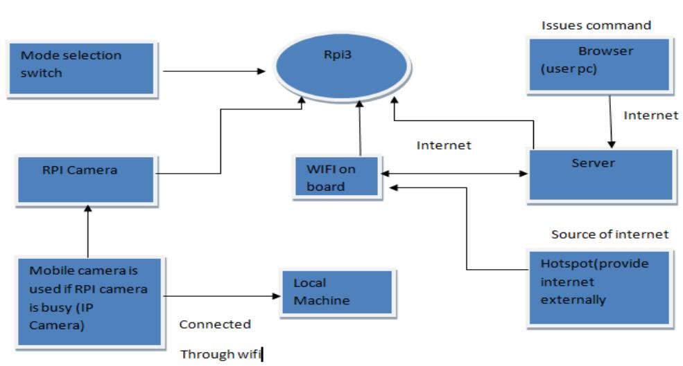
Functional Block Diagram
Concept Map of our project

Slide 11
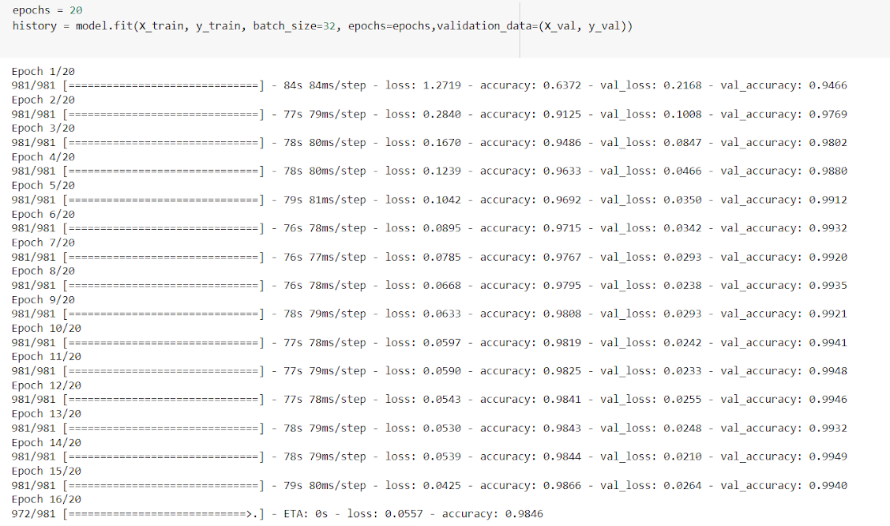
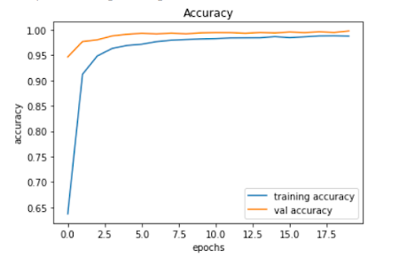
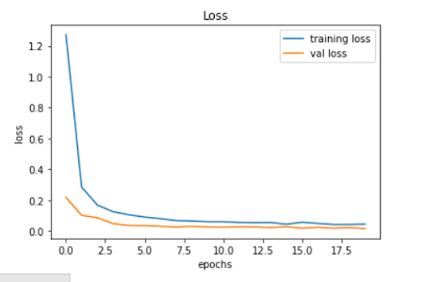
Simulation Results
Fig. Simulation results

Slide 12
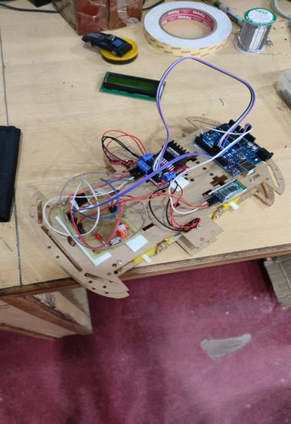
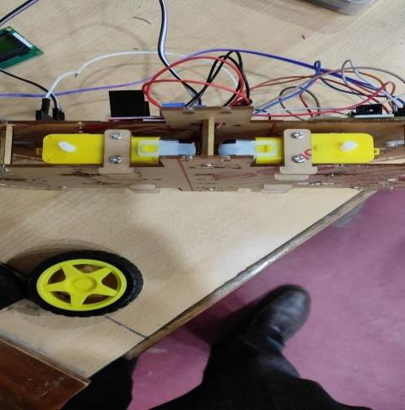
Hardware Results
Fig. Motor Connected to Circuit

Slide 13
Conclusion
This project if applied on the actual vehicle will certainly be able to reduce accidents on road.
The project will also help traffic regulation as well as controlling and regulating the crowd on the roads
t will help drivers while driving and keeping them mindful of the surrounding.
In the future, a high resolution camera can be used to accelerate and improve traffic sign
detection.
The work can be tested with advanced deep learning algorithms, such as You Only Look
Once (YOLO).
Automated traffic sign violation checks for a variety of additional traffic signs can be included in remote-controlled automobiles to add more automation.

Slide 14
References
Luo, Hengliang, Yi Yang, Bei Tong, Fuchao Wu, and Bin Fan. "Traffic sign recognition using a multi-task convolutional neural network." IEEE Transactions on Intelligent Transportation Systems 19, no. 4 (2017): 1100-1111. DOI: 10.1109/TITS.2017.2714691
Ju, Moran, Jiangning Luo, Panpan Zhang, Miao He, and Haibo Luo. "A simple and efficient network for small target detection." IEEE Access 7 (2019): 85771-85781. DOI: 10.1109/ACCESS.2019.2924960
Qin, Zhongbing, and Wei Qi Yan. "Traffic-sign recognition using deep learning." In International Symposium on Geometry and Vision, pp. 13-25. Springer, Cham, 2021. DOI : 10.1007/978-3-030-72073-5_2
Said, Riadh Ayachi1 Yahia ElFahem, and Mohamed Atri. "To Perform Road Signs Recognition for Autonomous Vehicles Using Cascaded Deep Learning Pipeline." Artificial Intelligence Advances. DOI: 10.30564/aia.v1i1.569
Zhang, Shiwen. Traffic sign detection for vision-based driver’s assistance in land-based vehicles. Technical report, School of Aeronautics and Astronautics-Stanford University, 2016.

Slide 15
6. Wan, Haifeng, Lei Gao, Manman Su, Qinglong You, Hui Qu, and Qirun Sun. "A novel neural network model for traffic sign detection and recognition under extreme conditions." Journal of Sensors 2021 (2021). DOI: 10.1155/2021/9984787
7. Nikhitha, M., K. P. Swetha, L. Nagamani Swathi, A. Sushma, and E. Sai Santhoshini. "TRAFFIC SIGN BOARD IDENTIFICATION AND VOICE VIGILANCE SYSTEM." Journal homepage: www. ijrpr. com ISSN 2582: 7421
8. Bailke, Preeti, and Kunjal Agrawal. "Traffic Sign Classification Using CNN." DOI: 10.22214/ijraset.2022.40224
9. Alghmgham, Danyah A., Ghazanfar Latif, Jaafar Alghazo, and Loay Alzubaidi. "Autonomous traffic sign (ATSR) detection and recognition using deep
10. Tabernik, Domen, and Danijel Skočaj. "Deep learning for large-scale traffic-sign detection and recognition." IEEE transactions on intelligent transportation systems 21, no. 4 (2019): 1427-1440. DOI : 10.1109/TITS.2019.2913588

Slide 16
Thank you

